Slide 1

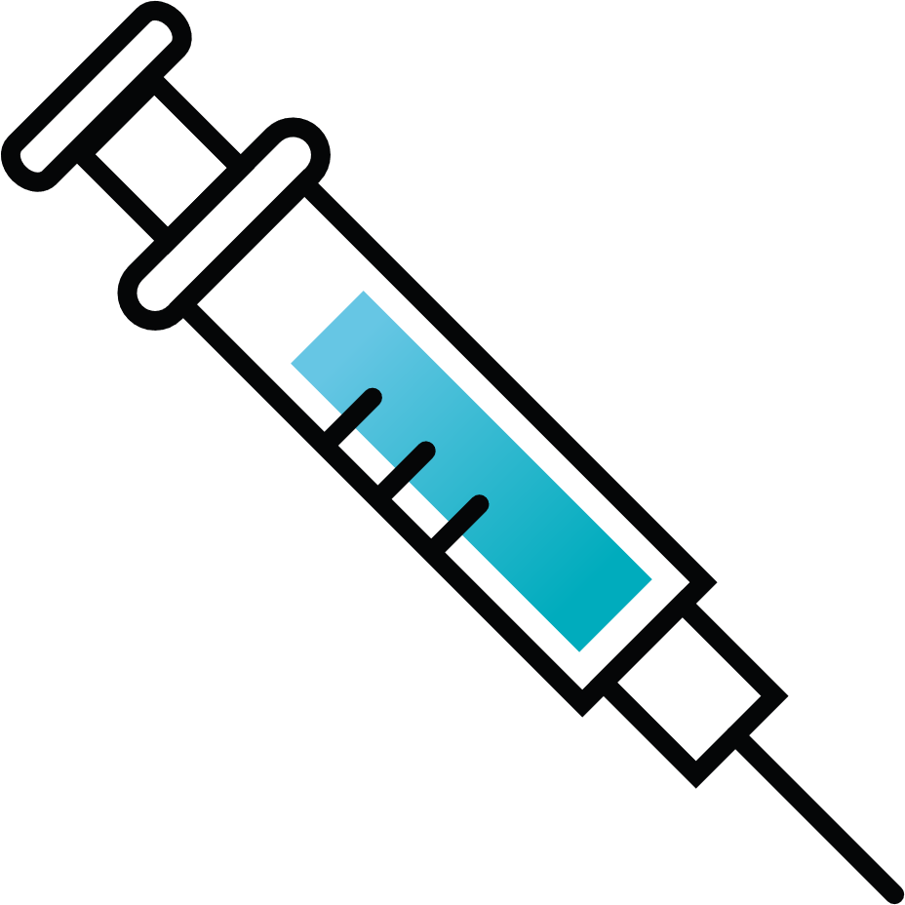
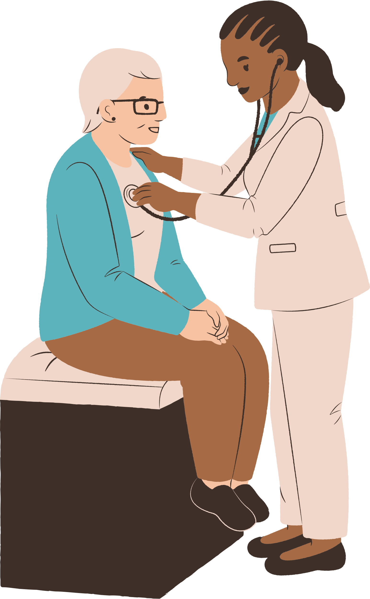



HEALTHCARE MANAGEMENT SYSTEM
Team Members:
Aliha Qaiser
Eeman Muzammil
Dania Saqib

Slide 2
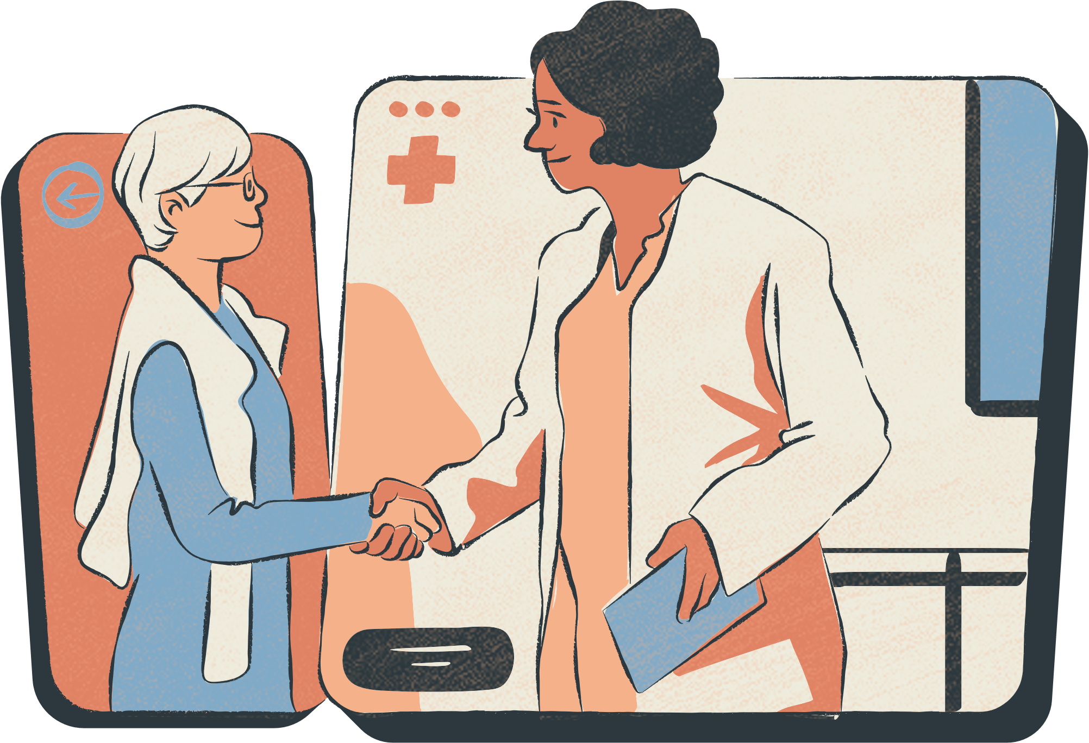


INTRODUCTION
The Healthcare Management System is designed to streamline hospital operations.
It helps in :
patient registration
appointment scheduling
medical records
billing
security
The project is developed using Agile and Scrum methodologies for efficient management.

Slide 3

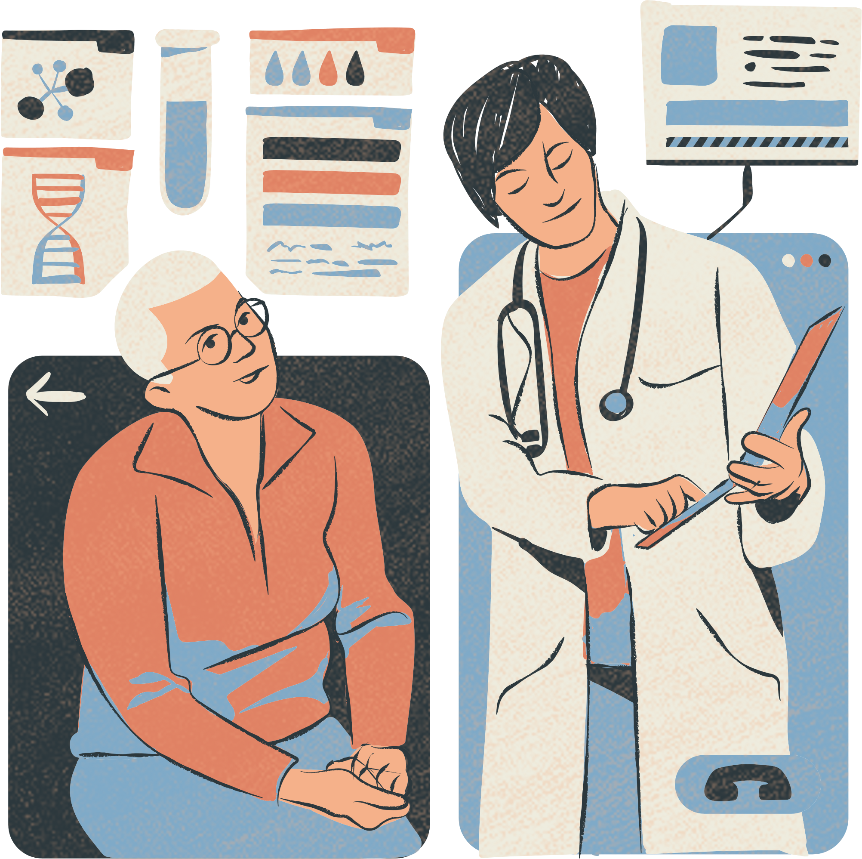
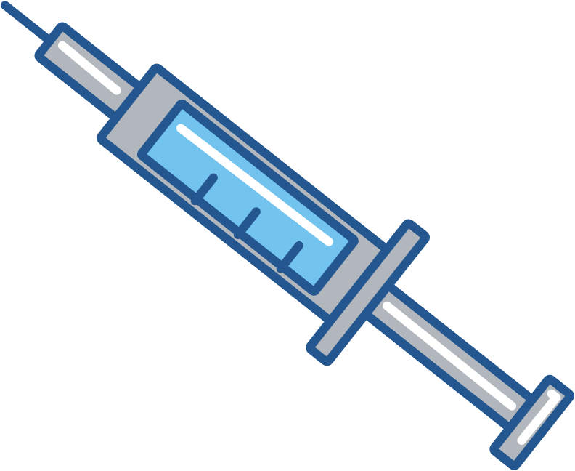
OBJECTIVES
Streamline Patient Registration & Scheduling (Faster & paperless process)
Integrate Secure Electronic Health Records (EHR) (Access patient history easily)
Automate Billing & Payment Processing (Faster invoicing & payment options)
Improve Hospital Staff Management (Better team coordination)
Enhance Security & Performance (Data protection, encryption, speed optimization)

Slide 4
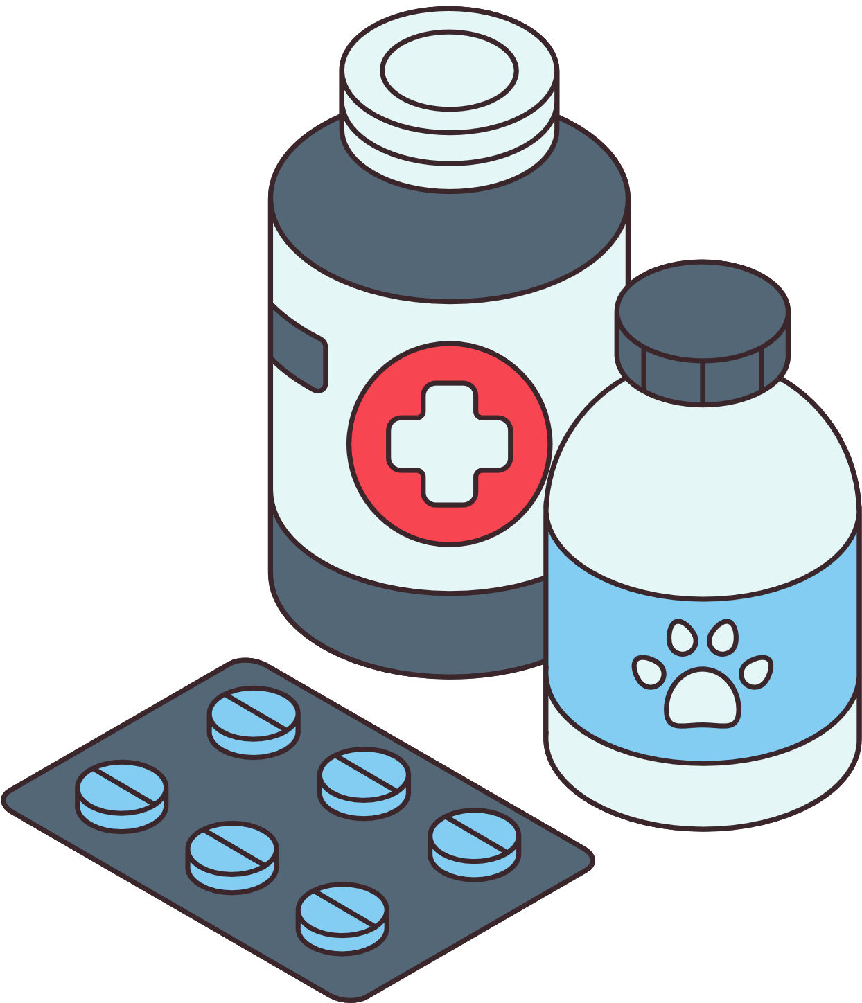
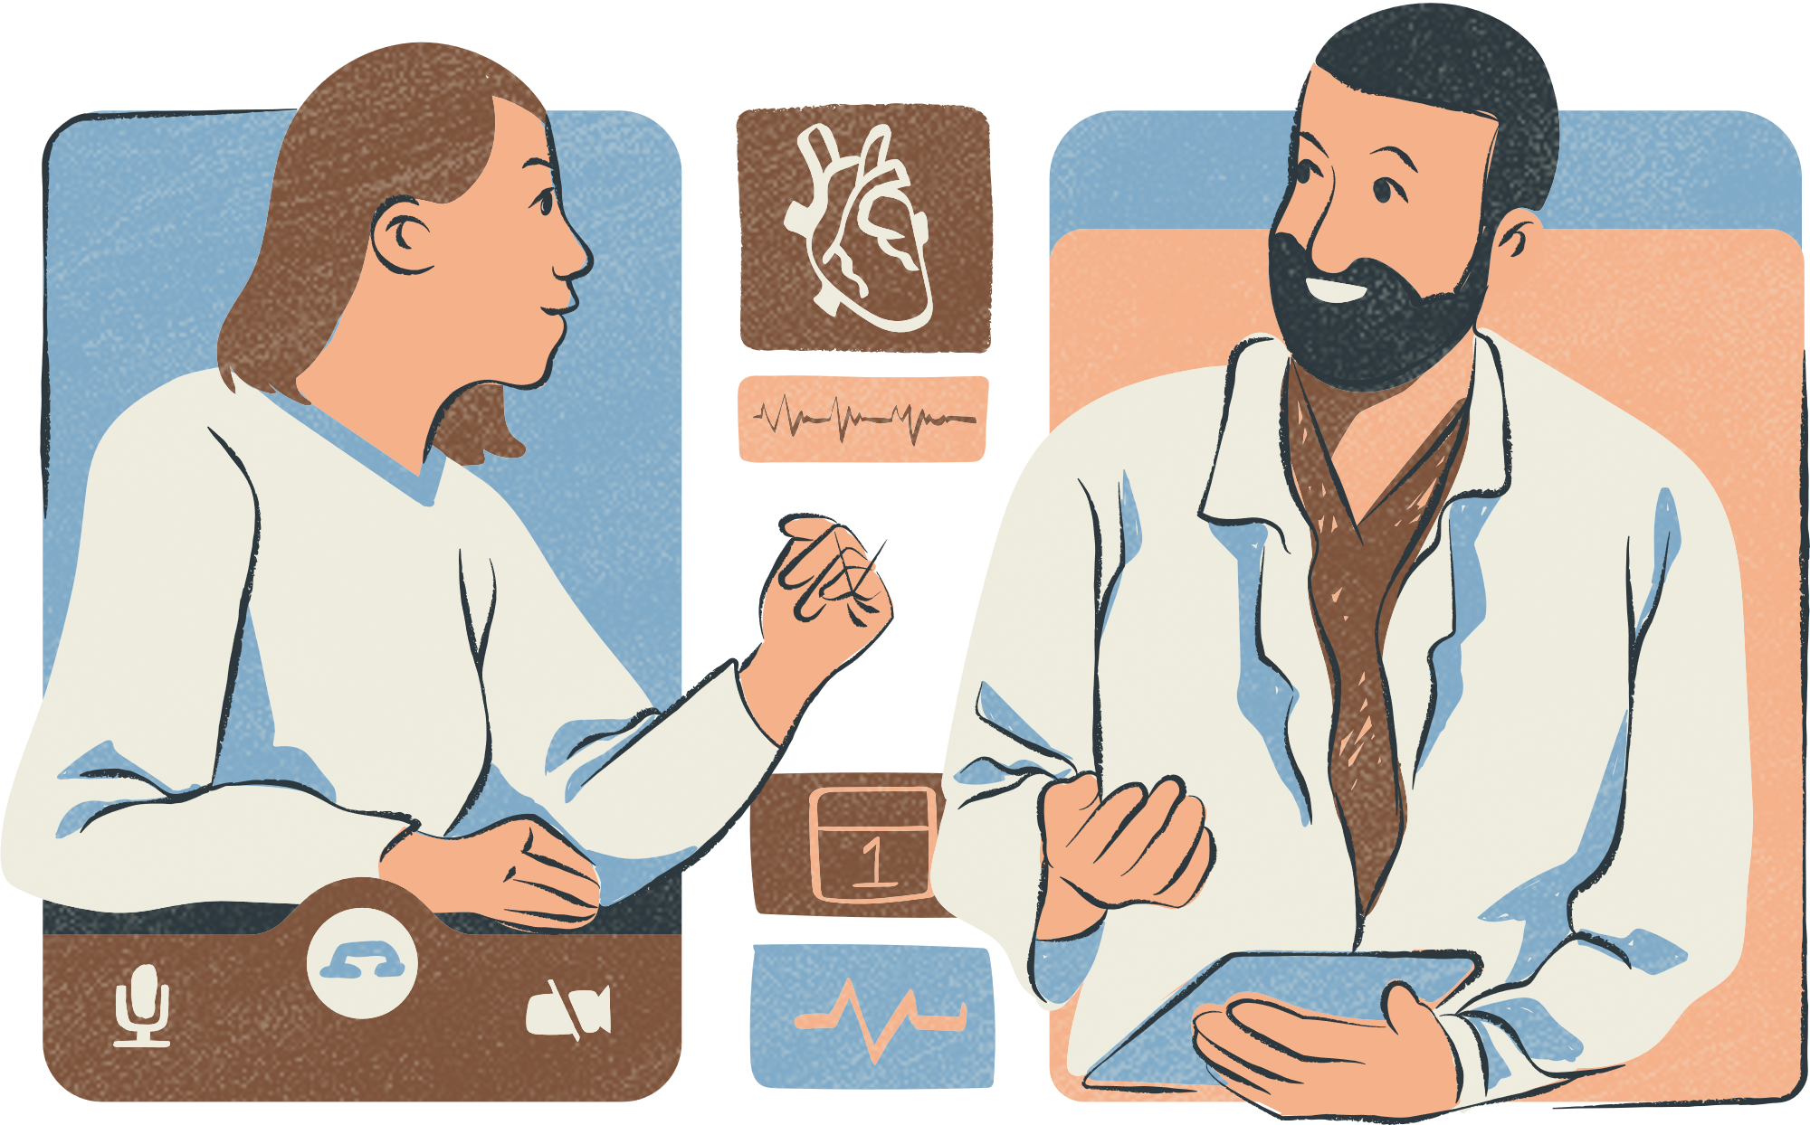

AGILE AND SCRUM METHODOLOGY
The Scrum framework is used to break the project into 6 sprints.
Each sprint includes:
planning
daily standups
sprint review
retrospective.
The project is managed using Trello Scrum Board to track tasks.
Planning → Sprint → Review

Slide 5
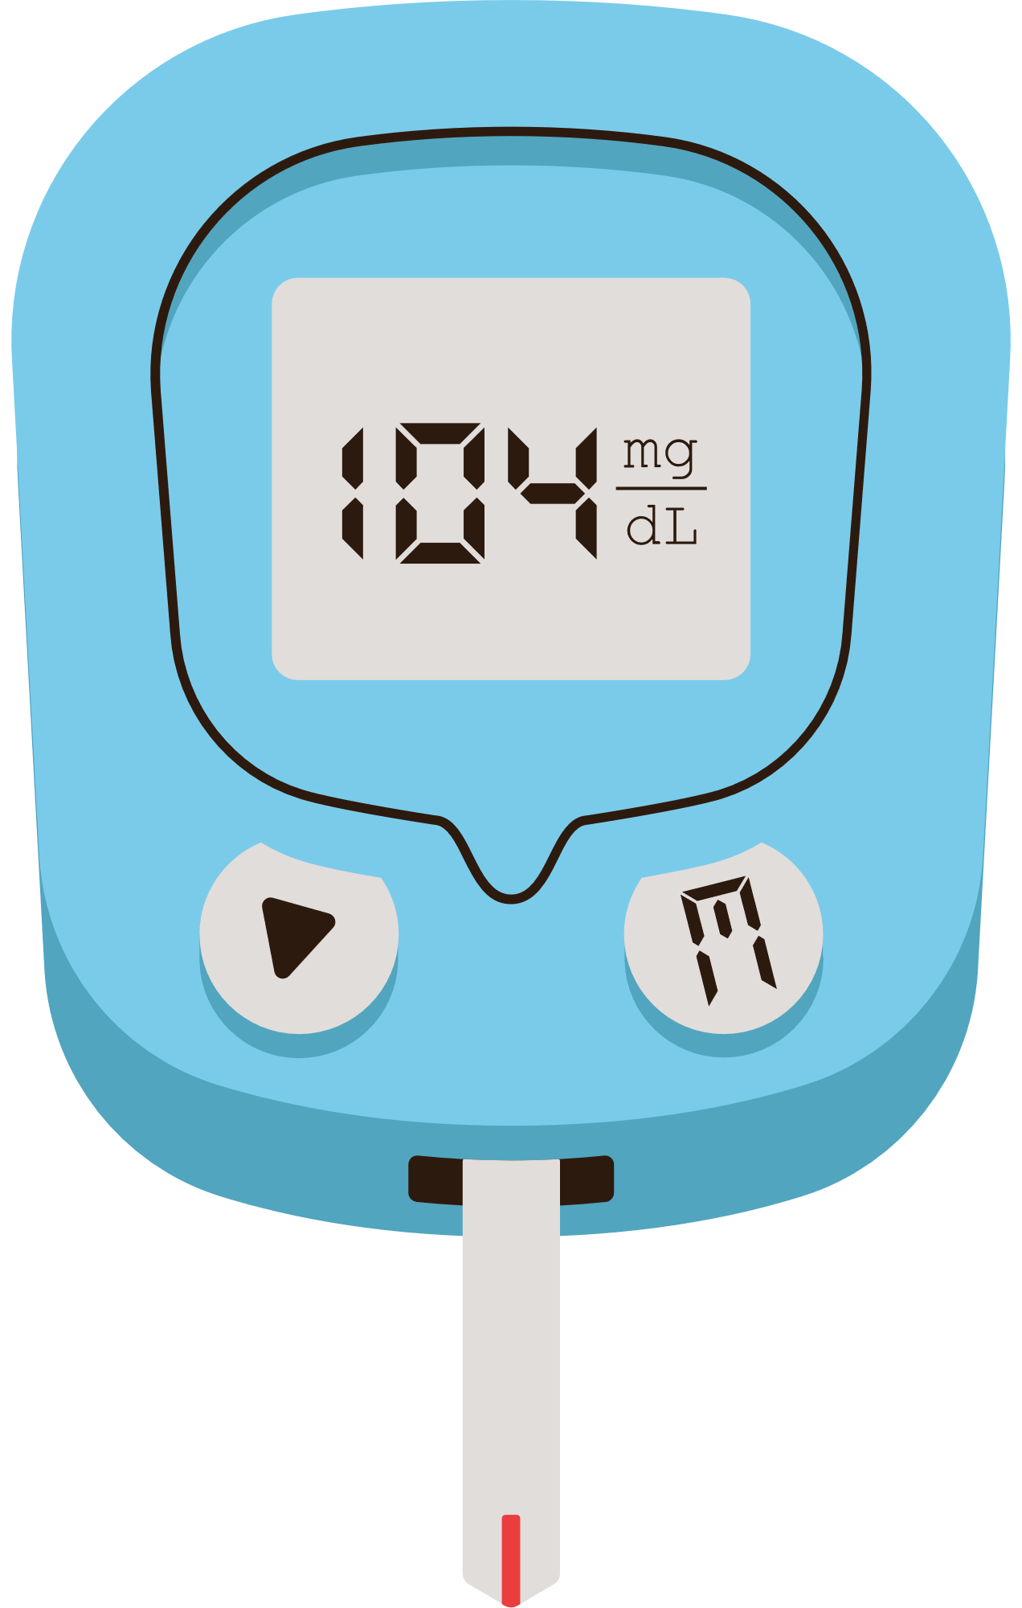
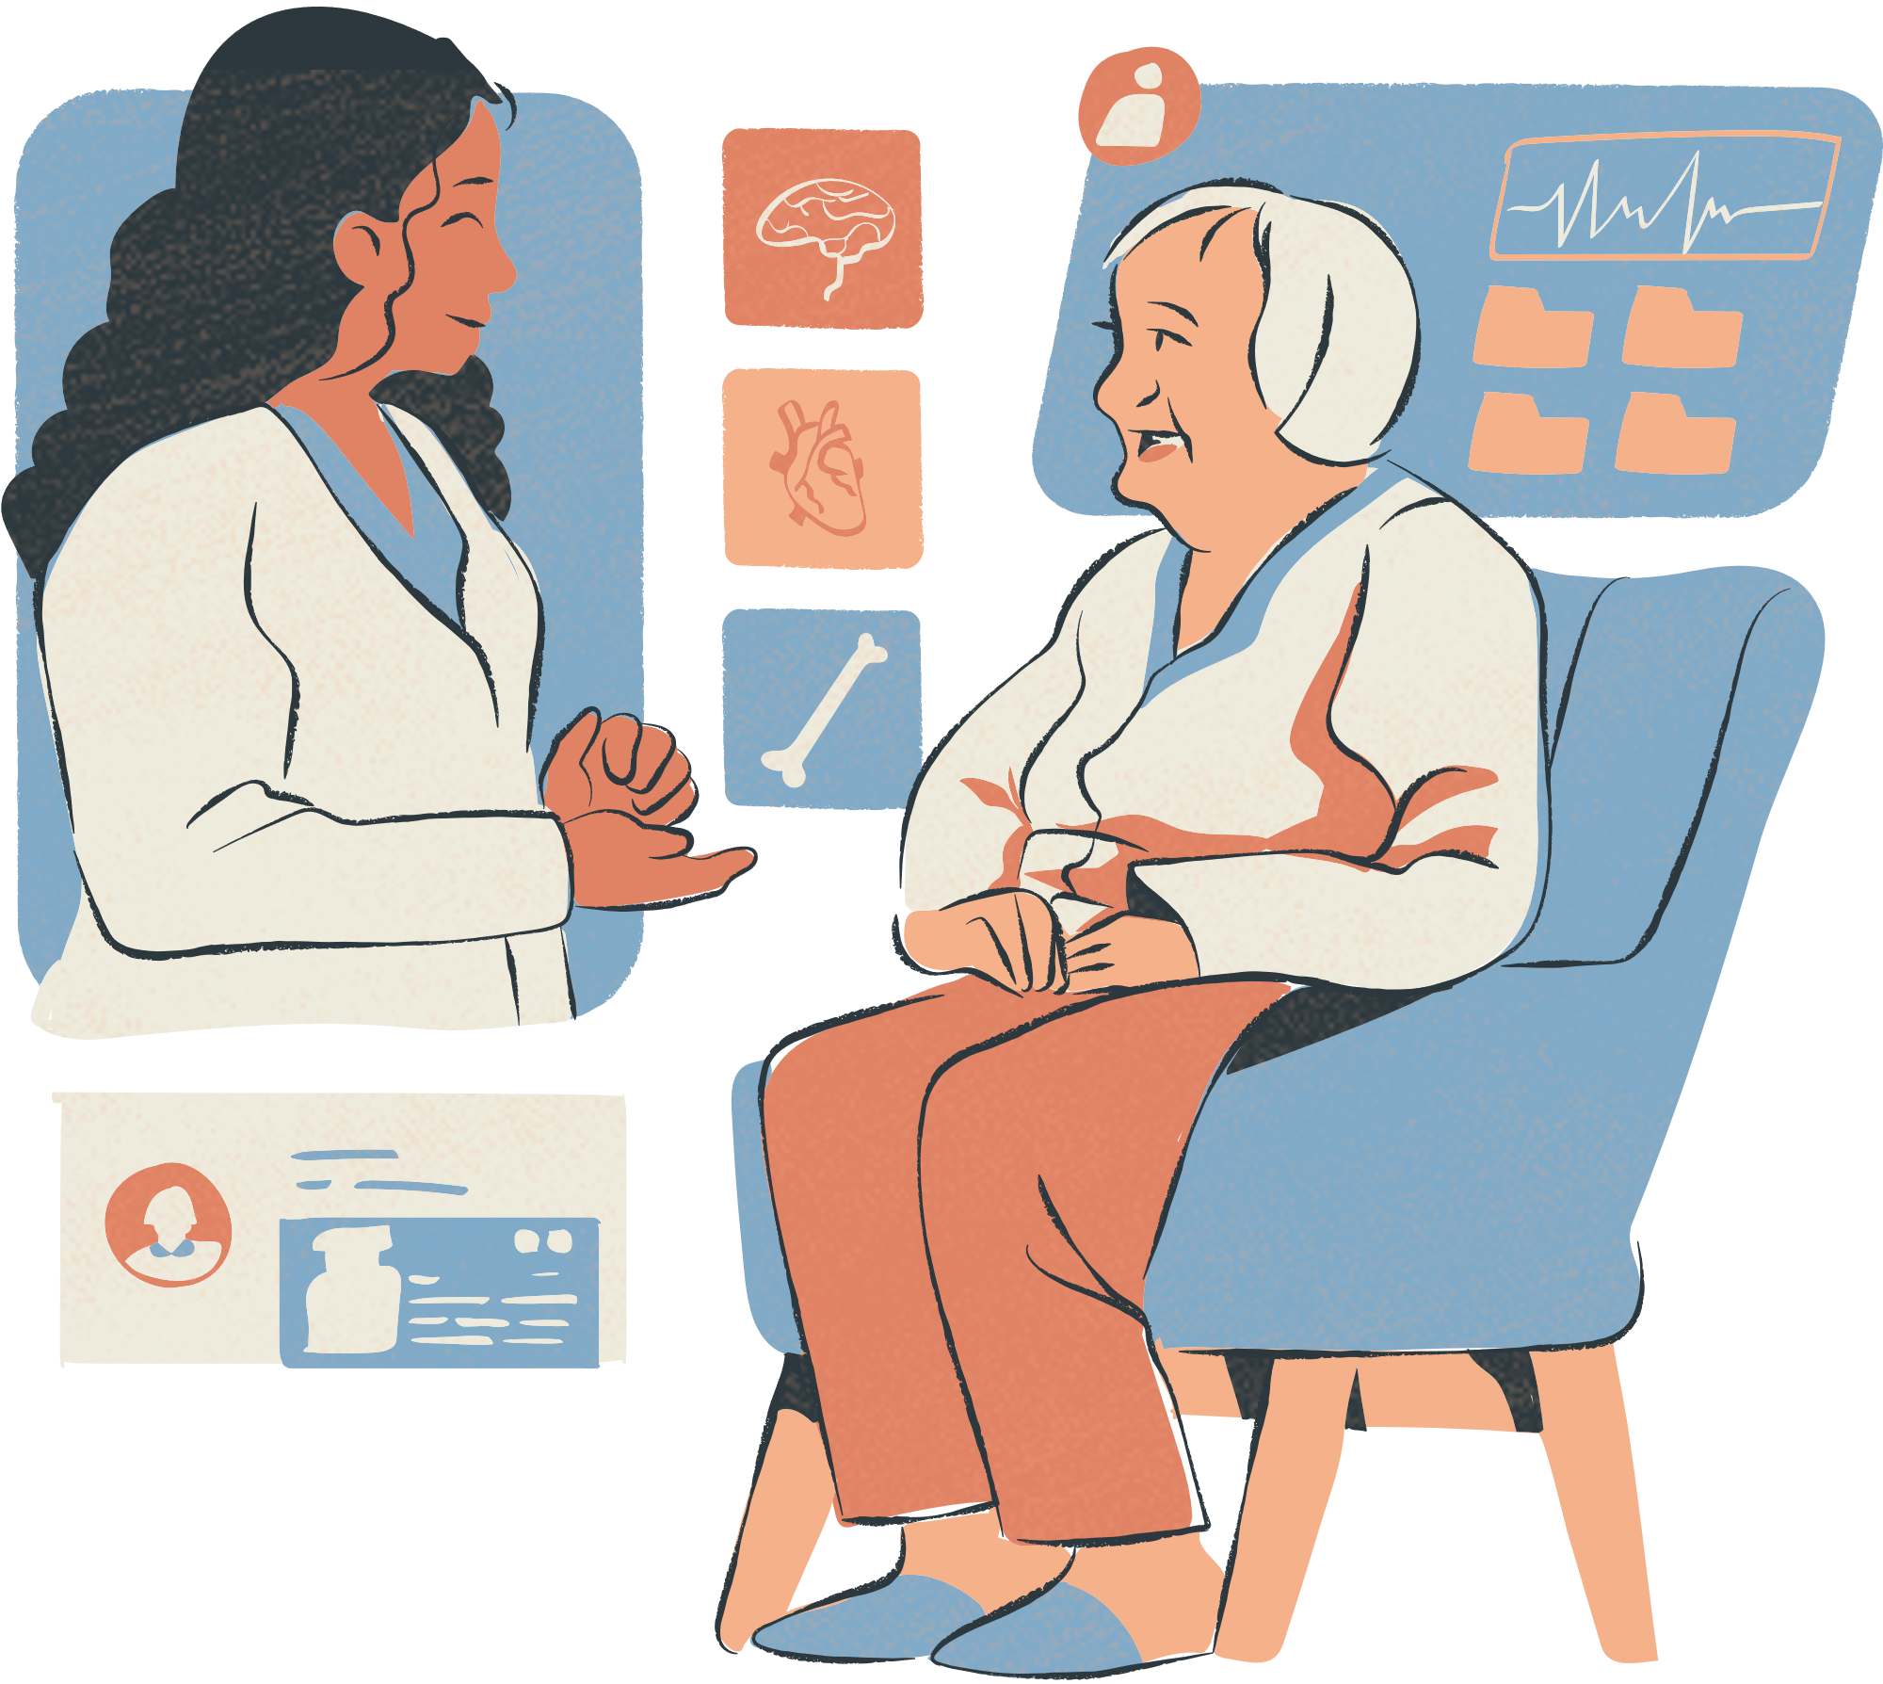

SPRINT BREAKDOWN
Sprint 1 Patient Registration & Appointment Scheduling
Sprint 2 EHR Integration
Sprint 3 Billing & Payment Processing
Sprint 4 Staff & Admin Management
Sprint 5 Security & Performance Optimization
Sprint 6 Final Testing & Deployment

Slide 6

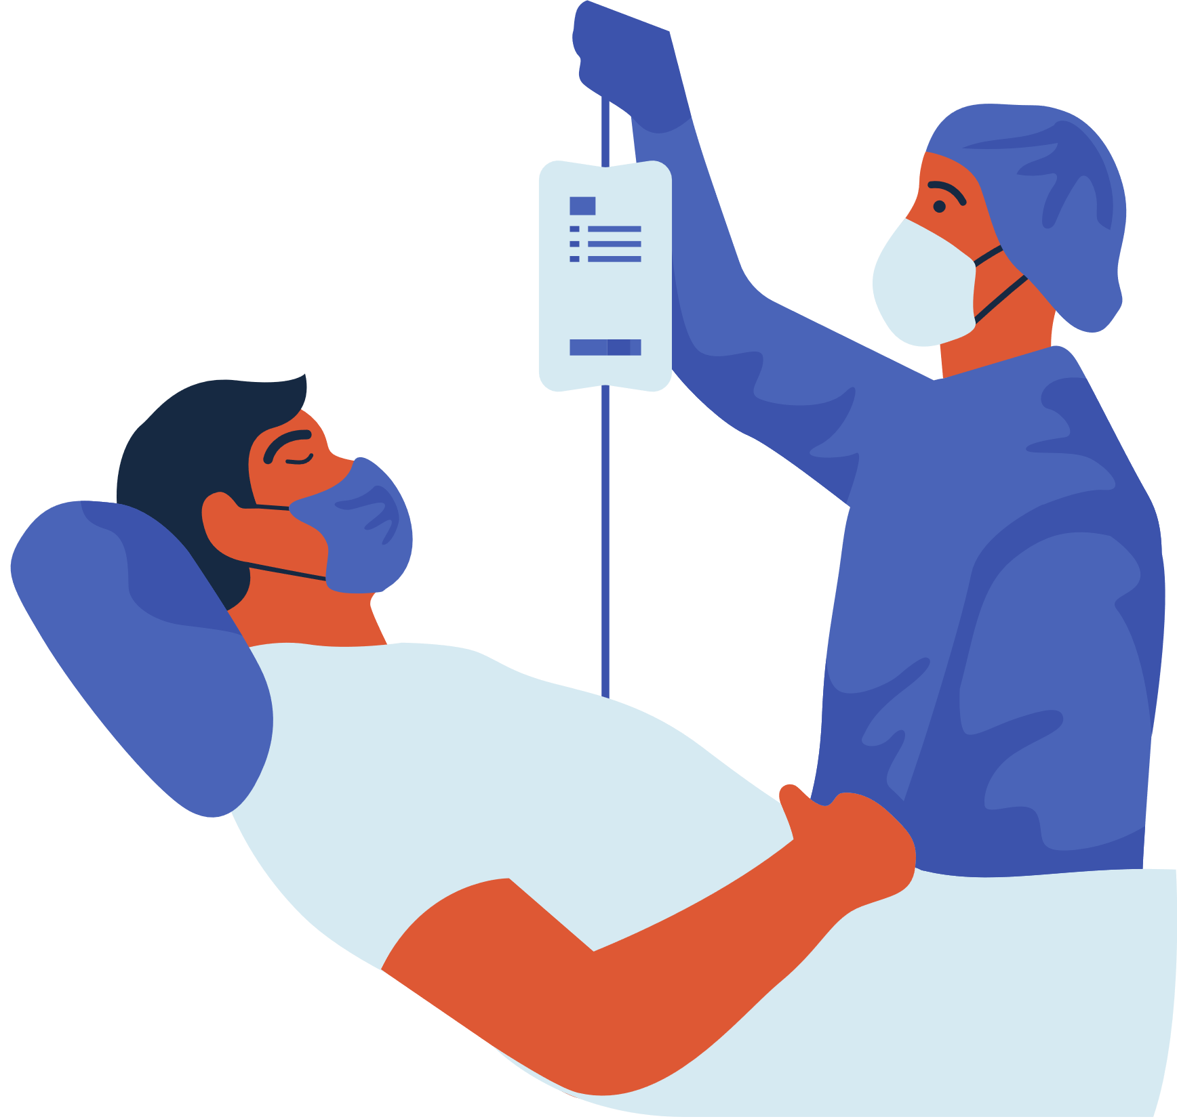
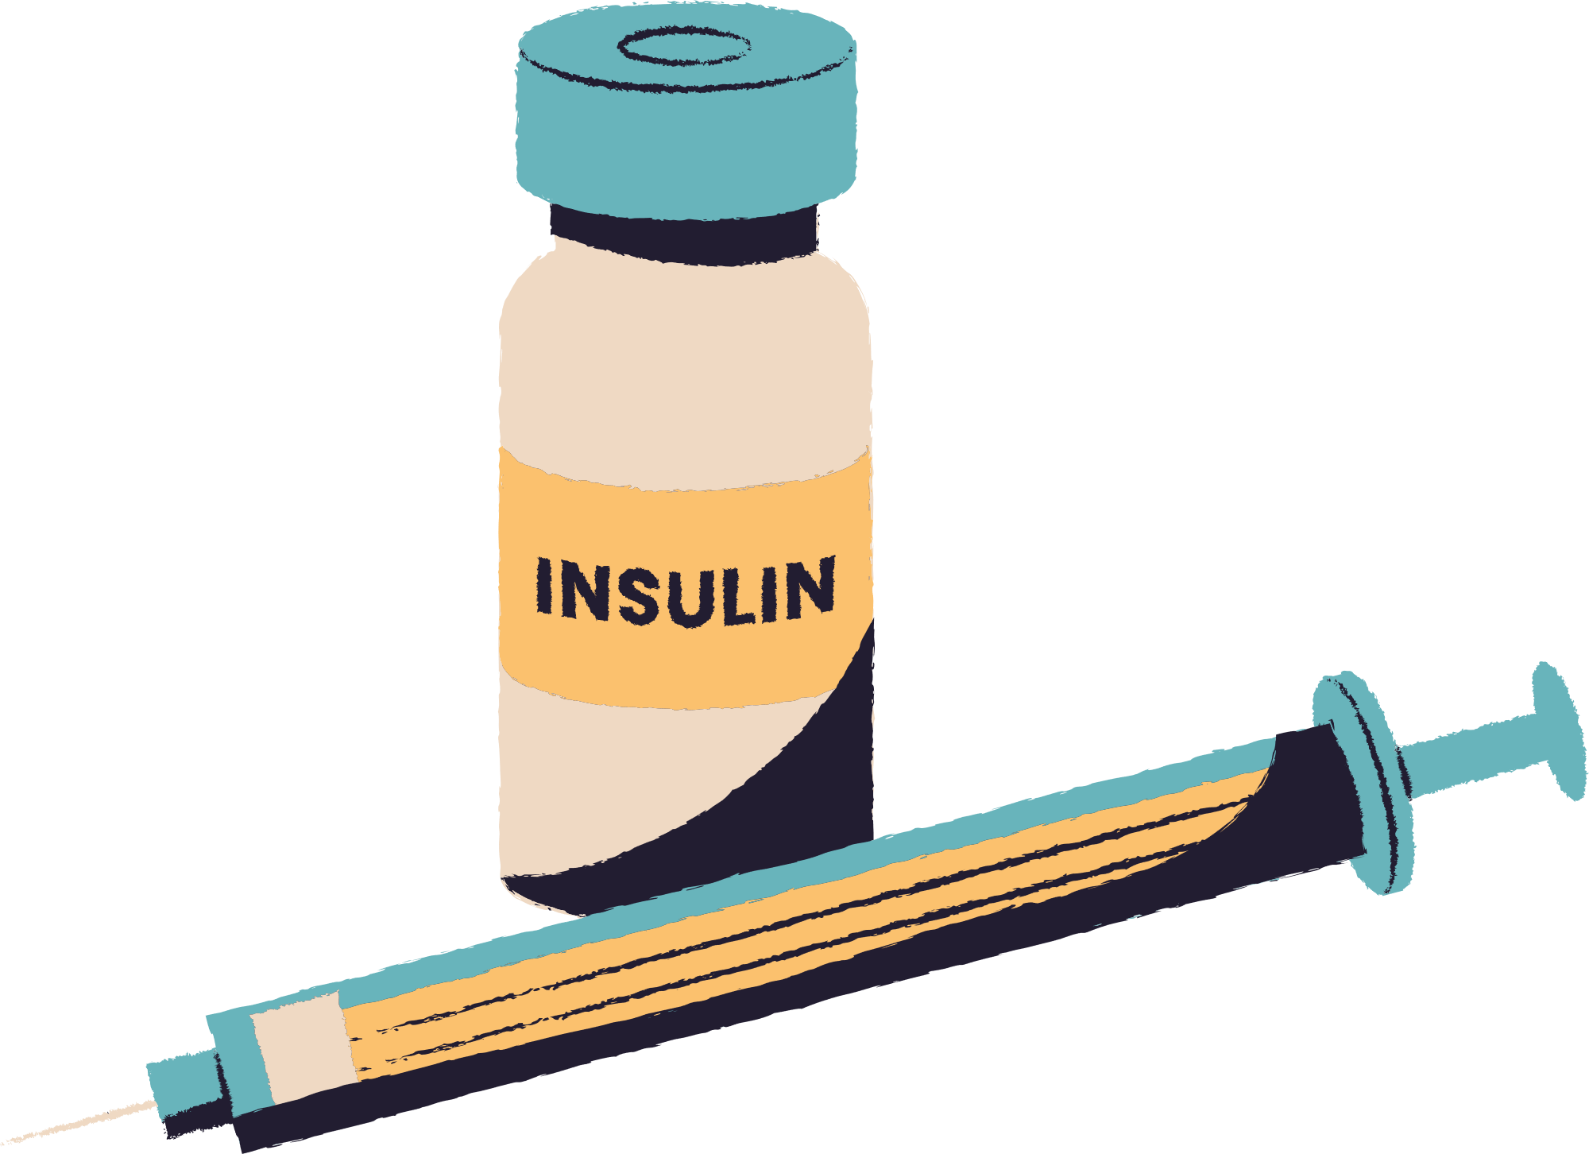
CONCLUSION
The ultimate goal is to provide hospital management system which is:
secure
efficient
user-friendly
scalable
provides enhanced patient care

Slide 7
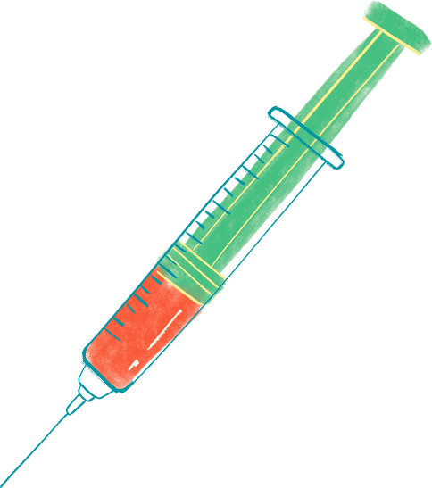



THANKYOU!

